Slide 1
CSE 438: Data Science For Practitioners Paper Review
Title: NELLIE: Never-Ending Linking for Linked Open Data
Authors: ABDULLAH FATHI AHMED, MOHAMED AHMED SHERIF, AXEL-CYRILLE NGONGA NGOMO
Published in 1 August 2023
Paper reviewed by: Md. Mahfujul Haque
ID: 20101388
Section: 01
Group: 14
ST - Mehnaz Ara Fazal
RA - Md Sabbir Hossain
Course Instructor: Annajiat Alim Rasel

Slide 2
Contents
Introduction to NELLIE: Unifying Knowledge Graphs | Slide 3 - 5
Knowledge Graphs: Fundamentals | Slide 6 - 7
NELLIE Pipeline Architecture | Slide 8 - 9
Evaluating NELLIE | Slide 10 - 11
Contextualizing NELLIE: Related Work | Slide 12 - 17
NELLIE's Future Path | Slide 18

Slide 3
Introduction to NELLIE: Unifying Knowledge Graphs
Knowledge graphs are essential for web-based applications (search engines, question answering, etc.)
Challenges in unifying separate knowledge graphs
Introduction to NELLIE: a pipeline to integrate knowledge graphs
NELLIE's goal: create a continuously updated, unified knowledge graph

Slide 4
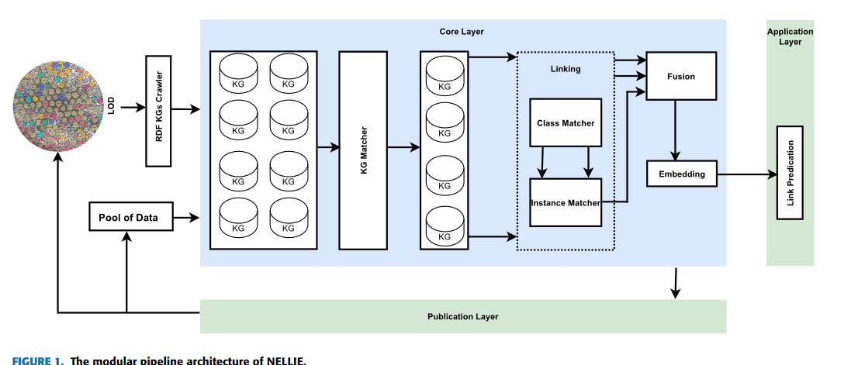

Slide 5
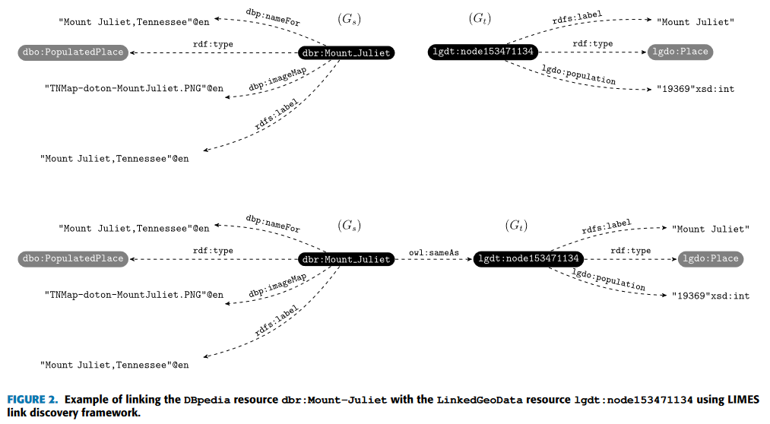

Slide 6
Knowledge Graphs: Fundamentals
Definition of a Knowledge Graph (KG)
Structure of KGs: sets of triples
Knowledge Graph Matching: ranking KGs for potential links
Key concepts: Link Specifications, Ontology Matching, Instance Matching, KG Fusion, Link Prediction

Slide 7
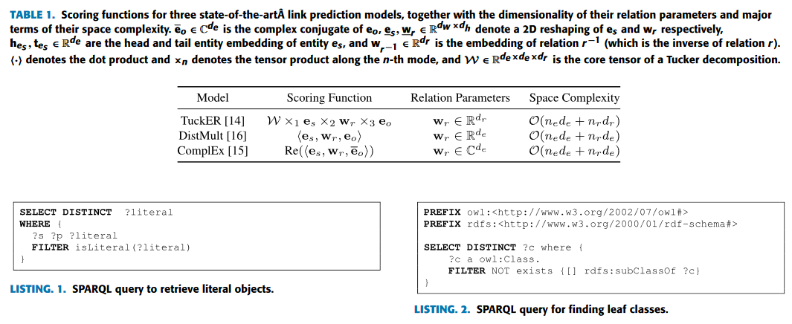

Slide 8
NELLIE Pipeline Architecture
Three layers: Core, Publication, and Application
Core functionalities: KG matching, linking, fusion, embedding
KG Matching methods: Metadata-Based, Content-Based, Manual
Linking process: Ontology matching followed by instance matching
Fusion strategy: combining mappings into a universal mapping

Slide 9
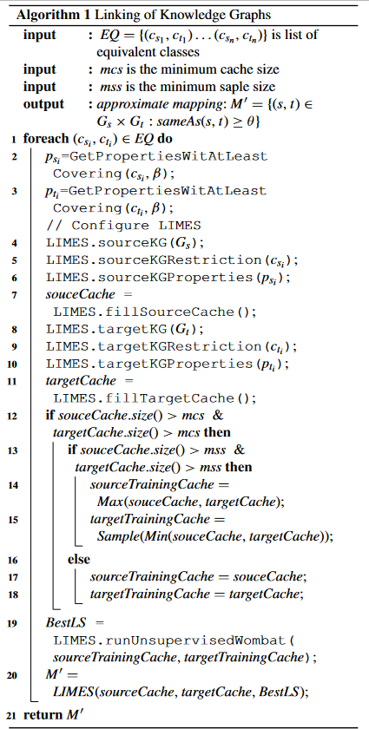
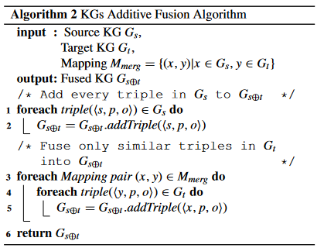

Slide 10
Evaluating NELLIE
Evaluation of KG matching, linking, fusion, embedding
Techniques assessed: Metadata-based, Content-based, Manual matching
Fusion impact on link prediction
Two-phase linking approach and its efficacy
Challenges and potential improvements

Slide 11
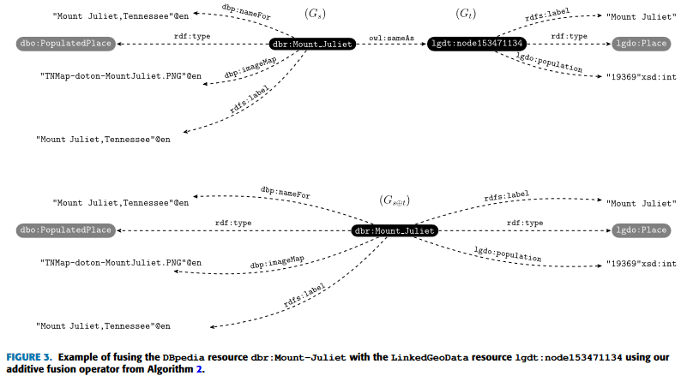
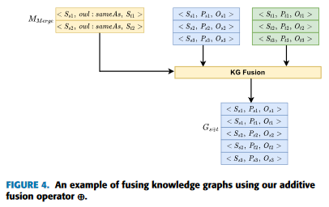

Slide 12
Contextualizing NELLIE: Related Work
Research areas: KG matching, Ontology/Instance matching, Data fusion, KG embedding
Overview of notable works in each area
Comparison with existing methods and systems
Contributions of NELLIE to the existing literature

Slide 13
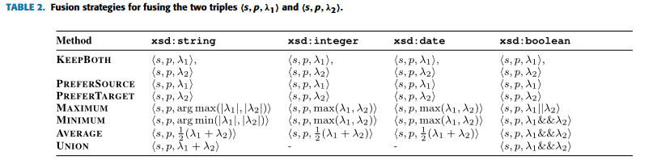
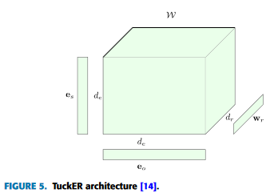
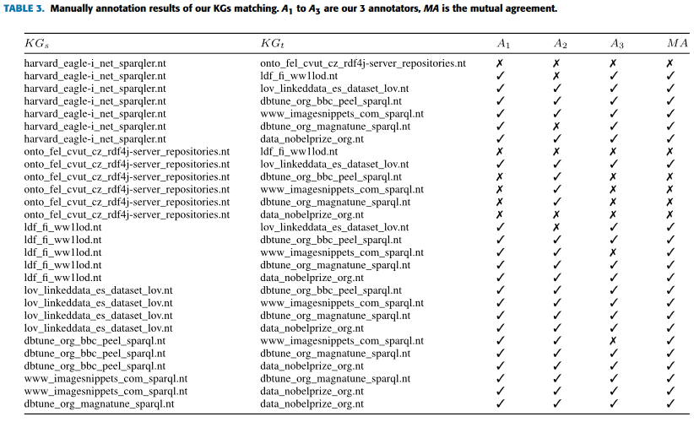

Slide 14
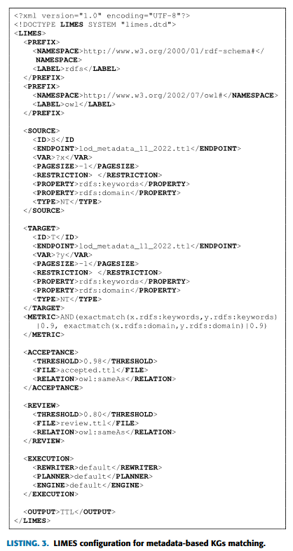
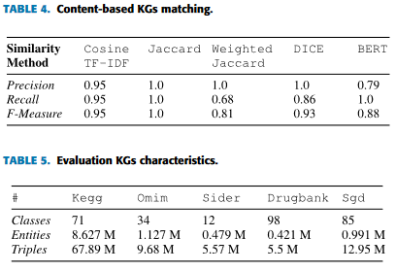

Slide 15
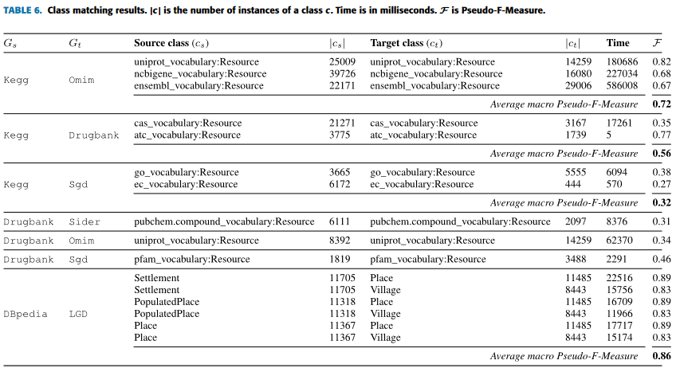

Slide 16
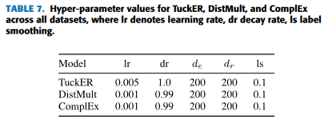
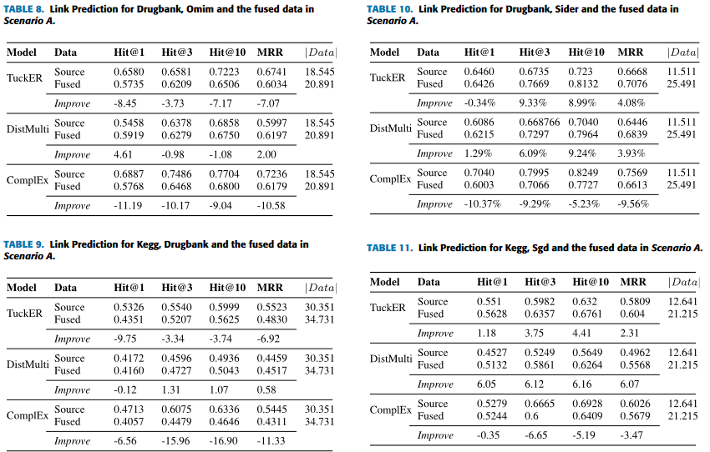
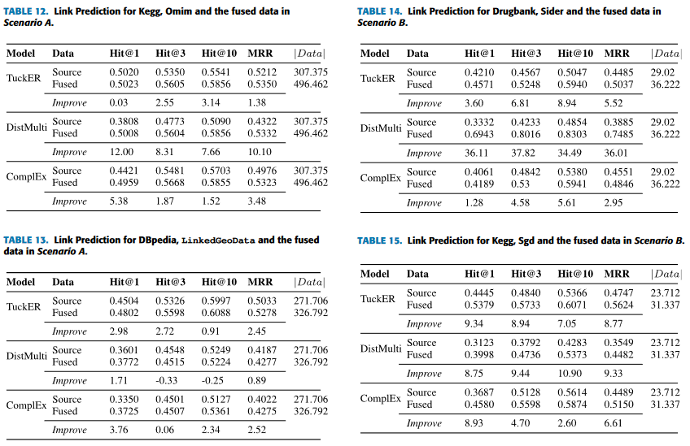

Slide 17
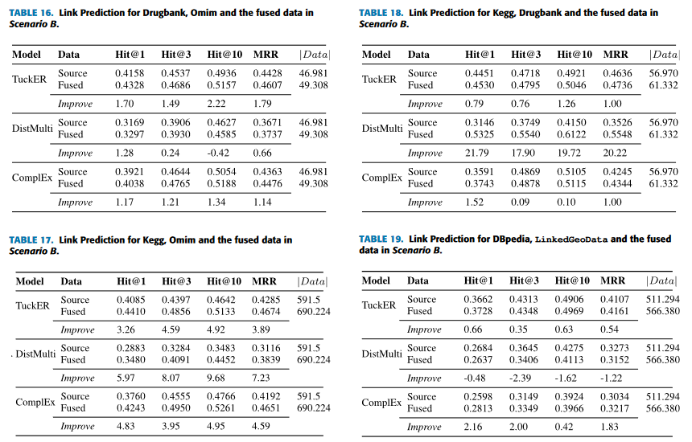

Slide 18
NELLIE's Future Path
NELLIE: A comprehensive solution for KG augmentation and fusion
Incremental approach in KG processing
Future plans: integration of more methods, benchmarks, fact-checking
Need for ongoing updates and refinements

Slide 19
Thank You

